Slide 1
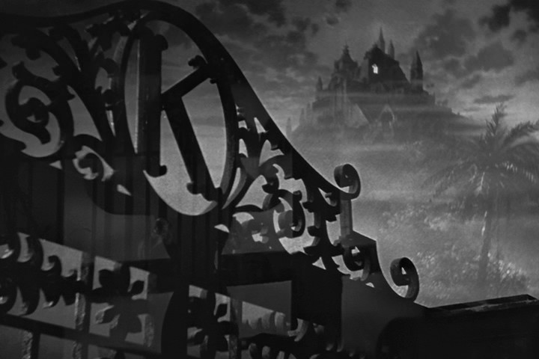
Citizen Kane (1941) by Orson Welles
Citizen Kane held greatest film of all time in polls for 50 years (ending its reign in 2012)

Slide 2
Some Facts
It was Orson Welles first feature film (he directed and starred in it). Orson Welles went on to do The Third Man series (directing, starring, and writing in 100’s of movies)
While a critical success, Citizen Kane failed to recoup its costs at the box office. The film faded from view soon after its release but its reputation was restored, initially by French critics, especially Jean-Paul Sartre, and more widely after its American revival in 1956.

Slide 3
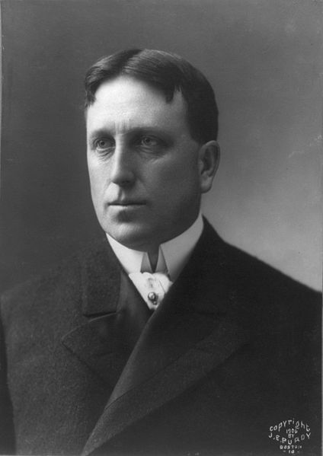
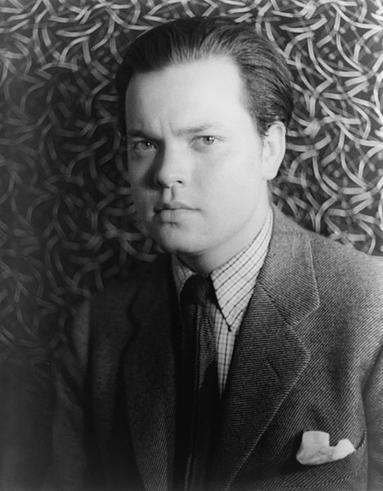
Plot
The story examines the life and legacy of Charles Foster Kane, played by Welles, a character based in part upon the American newspaper magnet William Randolph Hearst.
It doesn’t give a positive view of William Randolph Hearst, who tried to prevent the movie from being released.

Slide 4
William Randolph Hearst (April 29, 1863 – August 14, 1951)
He was an American newspaper publisher who built the nation’s largest newspaper chain and whose methods profoundly influenced American journalism. His father was a millionaire in the mining industry who also owned one magazine (where William first worked). Then he bought up many other newspapers over time. His newspapers/magazines were very popular.
He exerted great political influence (and held government offices at various times) and was blamed for influencing the U.S. involvement in a war with Spain in 1898. (Spanish-American War)

Slide 5
Continued
Moving to New York City, he acquired The New York Journal and engaged in a bitter circulation war with Joseph Pulitzer's New York World which led to the creation of yellow journalism —sensationalized stories with doubts of reality.
Acquiring more newspapers, Hearst created a chain that numbered nearly 30 papers in major American cities at its peak. He later expanded to magazines, creating the largest newspaper and magazine business in the world.
Just look on the binding of most magazines for the word Hearst.
He is also well-known for the only castle in California: Hearst Castle located in San Simeon, CA

Slide 6
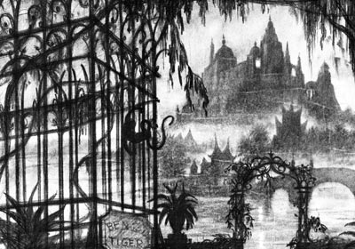
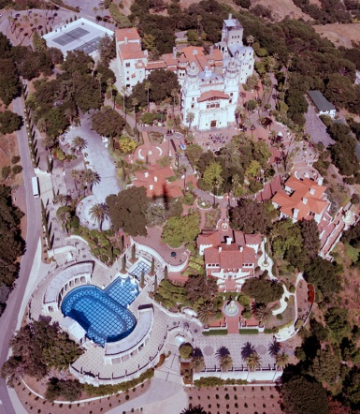
Film/Real Life Similarities and differences
Xanadu
Hearst Castle

Slide 7
Other Similarities/differences
Citizen Kane
William Randolph Hearst
Had a mistress who he made go into the opera even though it was terrible
Yellow journalism: Charles Foster Kane does this.
His parents gave him away so he could make it in the world.
Separated from his first wife.
Had no children.
Had a mistress named Marion Davies who he helped with her career by giving studios money/gifts (except she was actually a talented actress/comedian)
Yellow journalism: Hearst does this too.
His parents gave him a legacy and company but didn’t give him away.
Separated from his first wife.
Hearst had 5 kids with his first wife.

Slide 8
Technical Brilliance
Deep Focus Cinematography: everything is in full focus (nothing is blurry)
Creative camera angles like Dutch angle (camera tilted to one side) and many low angle shots.
Lots of long dissolves
Great themes about life: figure them out
A mystery surrounding Kane’s last words is a great way to bring audience into the story.
Film centers on flashbacks and interviews.
Heavy use of symbolism throughout
Lighting very creative, often backlit to create expressionist silhouettes.

Slide 9
Is it true?
Does the film portray William Randolph Hearst accurately?
Does it presume to know how he feels about his life, heart, and behaviors?
The film begs the question, at the end of your life, what will you regret not doing? Or missing?

