Slide 1
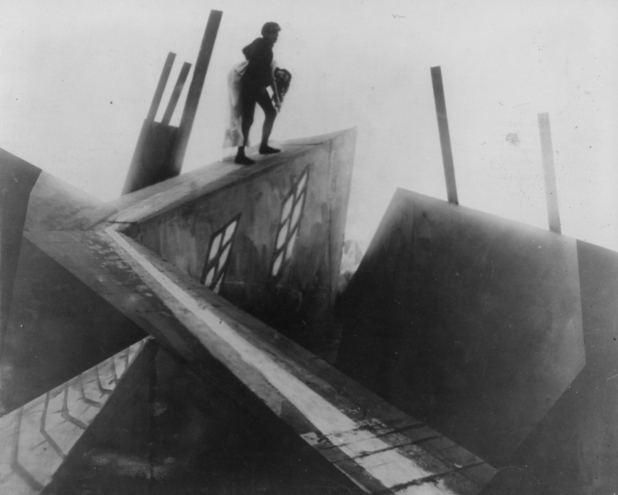
German Expressionism
And The Cabinet of Dr. Caligari

Slide 2
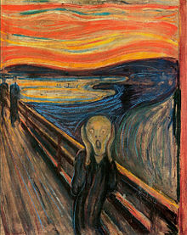
German Expressionism
It’s a major film movement starting the 20s.
An extreme distortion of the visual world to express inner emotional reality. It’s part of the modernist movement. You can critique realism by going against it.
German expressionist film-1) set designs have shading giving depth, large shapes, harsh colors, hard graphic outlines, and violation of traditional perspective 2) acting is exaggerated
A goal of expressionism is to abstract, distort, and transcend the look of everyday reality in order to represent the world as an artist sees or experiences it.
Subjective Vs. Objective- a camera and story can be subjective or objective. Subjective: based on personal beliefs, feelings, thoughts. Objective: Based on facts, reality, observable/verifiable information.

Slide 3
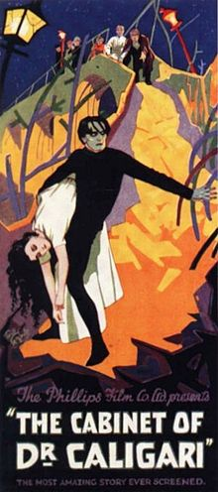
The Cabinet of Dr. Caligari
WWI film in Germany- Government interfered in the film industry to create blood thirsty propaganda. Expressionists tried to show govt's. abuse of power. They do this in the film.
The Cabinet of Dr. Caligari (Robert Wiene,1920)
It has a focus on murder/death/doom/violence/social instability. It’s a silent horror film.
Characters are Cesare, a somnambulist-chronic sleeper, Dr. Caligari who takes care of him, and Francis who is narrating.
Types of narration: Omniscient is all knowing 1st person is from the person's own experiences 3rd person is from 1 outside person Unreliable narrator is anyone, not good with reality, this could be a child, mental patient, or other crazy or naive person
The movie is cited as having the first twist ending.

Slide 4
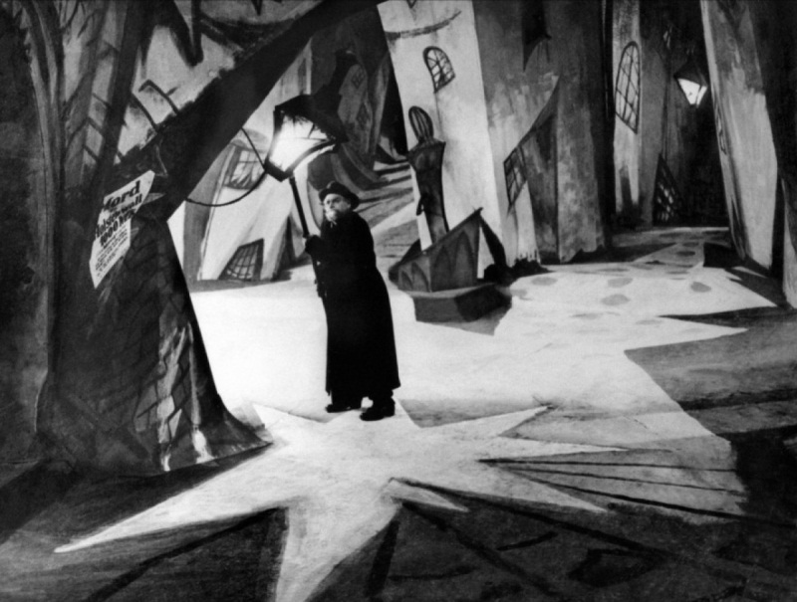
The Production
For the production of the film, they did not have expensive lights and power was by quota so they decided to paint on the lights and shadows. They hired expressionist artists to do this.
Your biggest question throughout the film may be, what’s real? The other question you’ll be asking is how do the lighting/sets go with the story and how do they show symbolism?

